Slide 1
Data Analysis Project
Analyzing the Impact of Language Isolation on Median Income in Dallas County

Slide 2
Introduction / Hypothesis
Study Focus: To find out the relationship between the percent of Linguistically Isolated Households and Median Income in Dallas County
Challenges in Linguistically Isolated Households:
Defined as homes where no one over age 14 speaks English 'well' or 'very well'.
These households may face disadvantages due to limited English proficiency:
Reduced parental competitiveness in the labor market.
Lower family resources and poorer community locations.
Barriers to positive cognitive and academic outcomes.
Difficulty accessing healthcare and other services

Slide 3
Data Collection
We collected data from the ACS 2019 for Dallas County tracts, including variables on language isolation, education, employment, and median income.
The data is split into different categories based on what type of language the households speak (Spanish, Indo- European other than Spanish, Asian and Pacific, and Other)
The number of people with Bachelors/Masters Degrees and the Total Population
Total number of people in the Labor Force and Total number of people Currently Employed

Slide 4
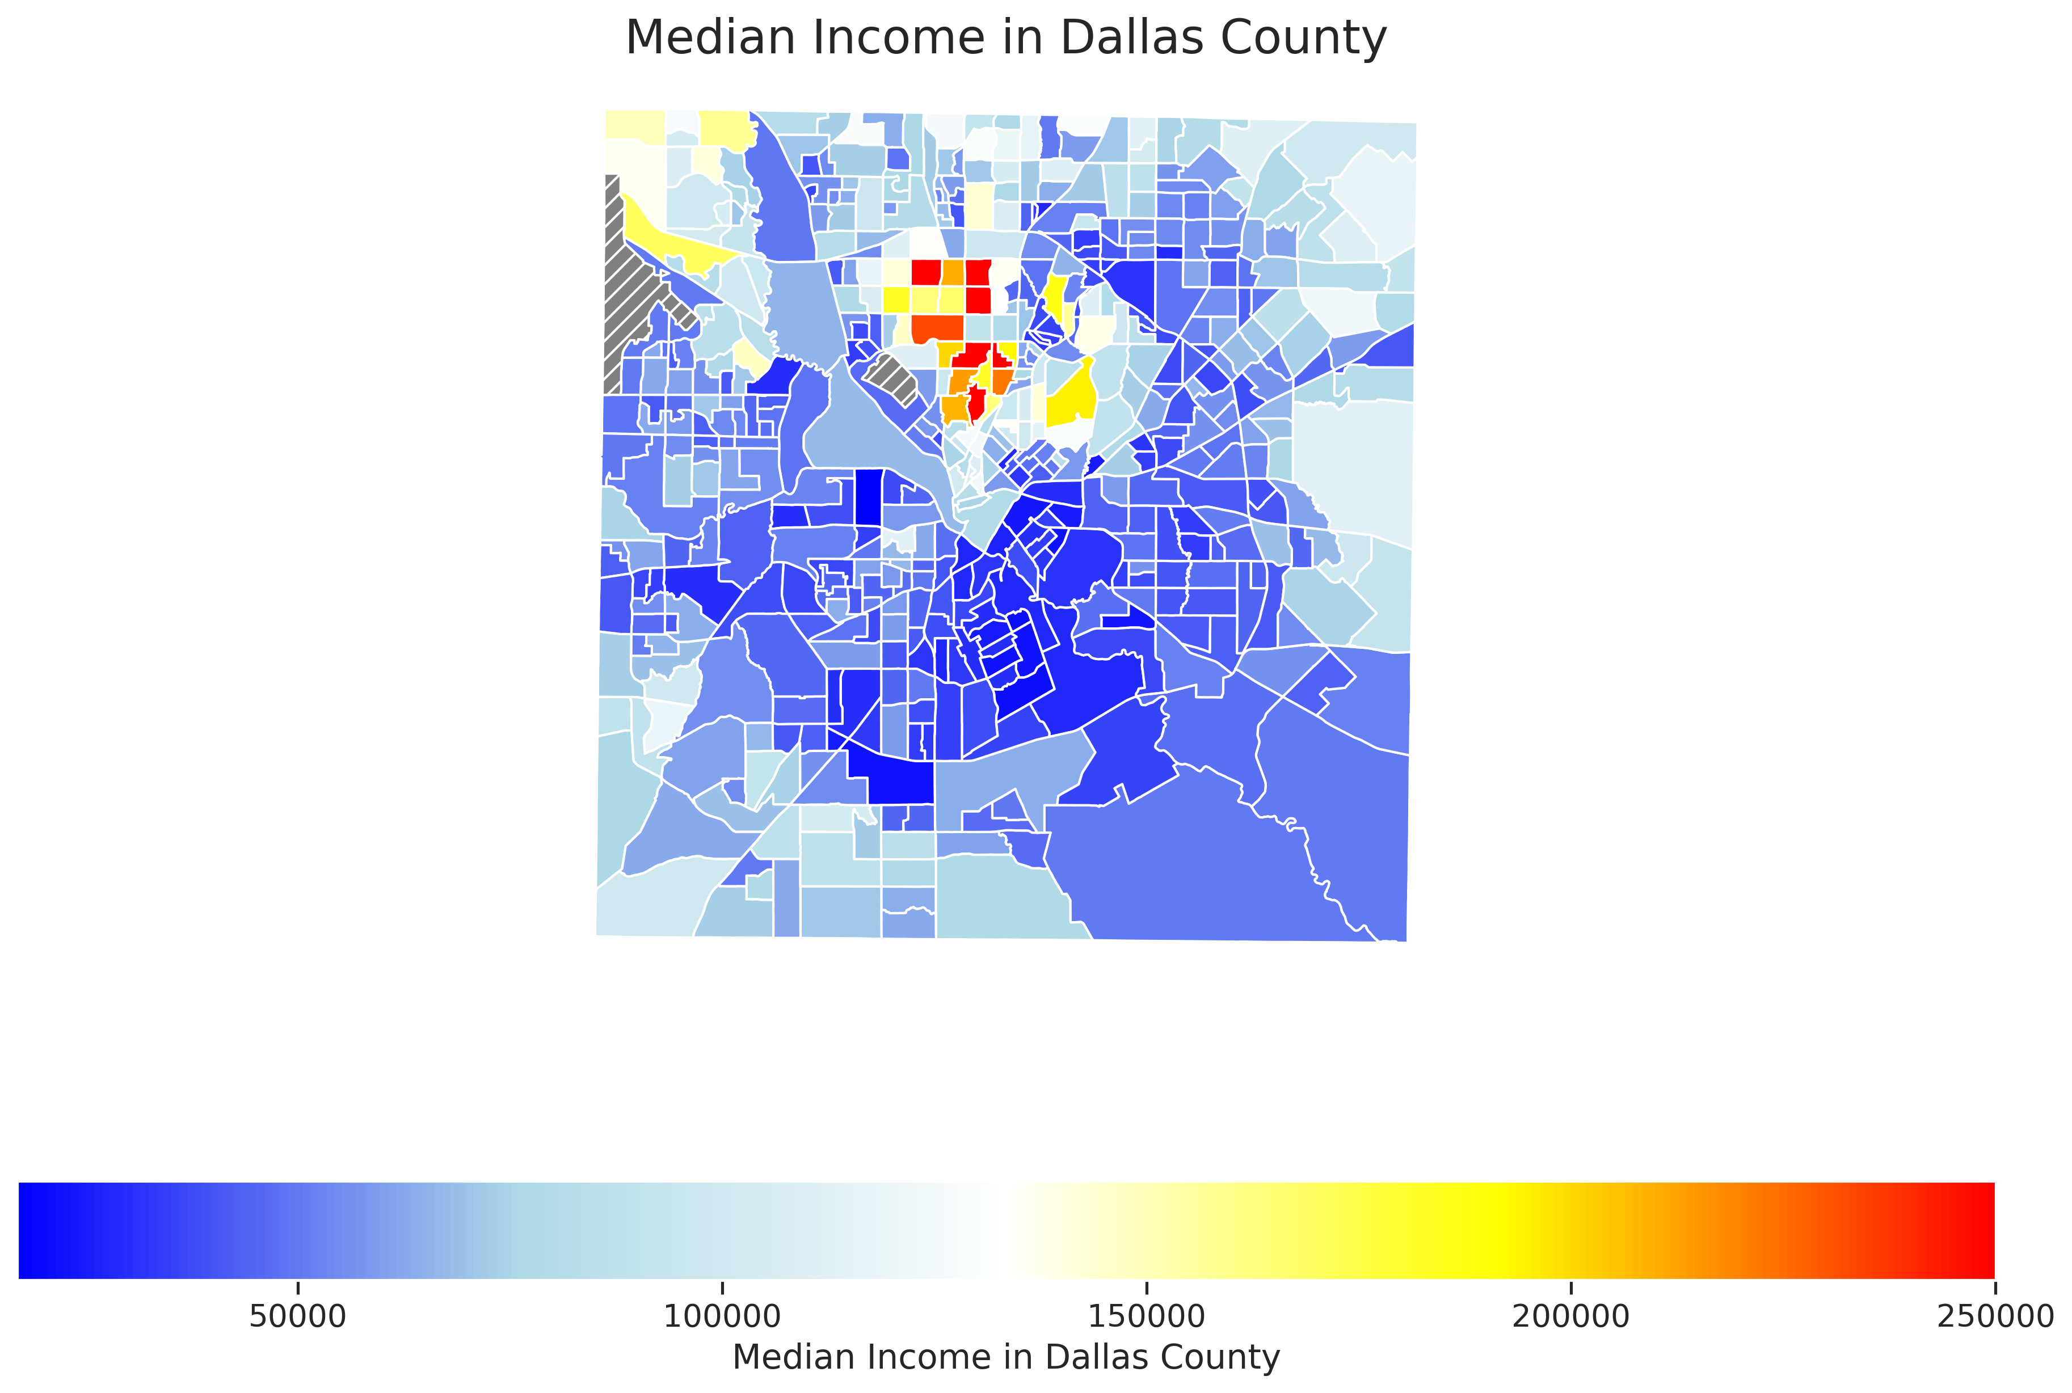
`

Slide 5
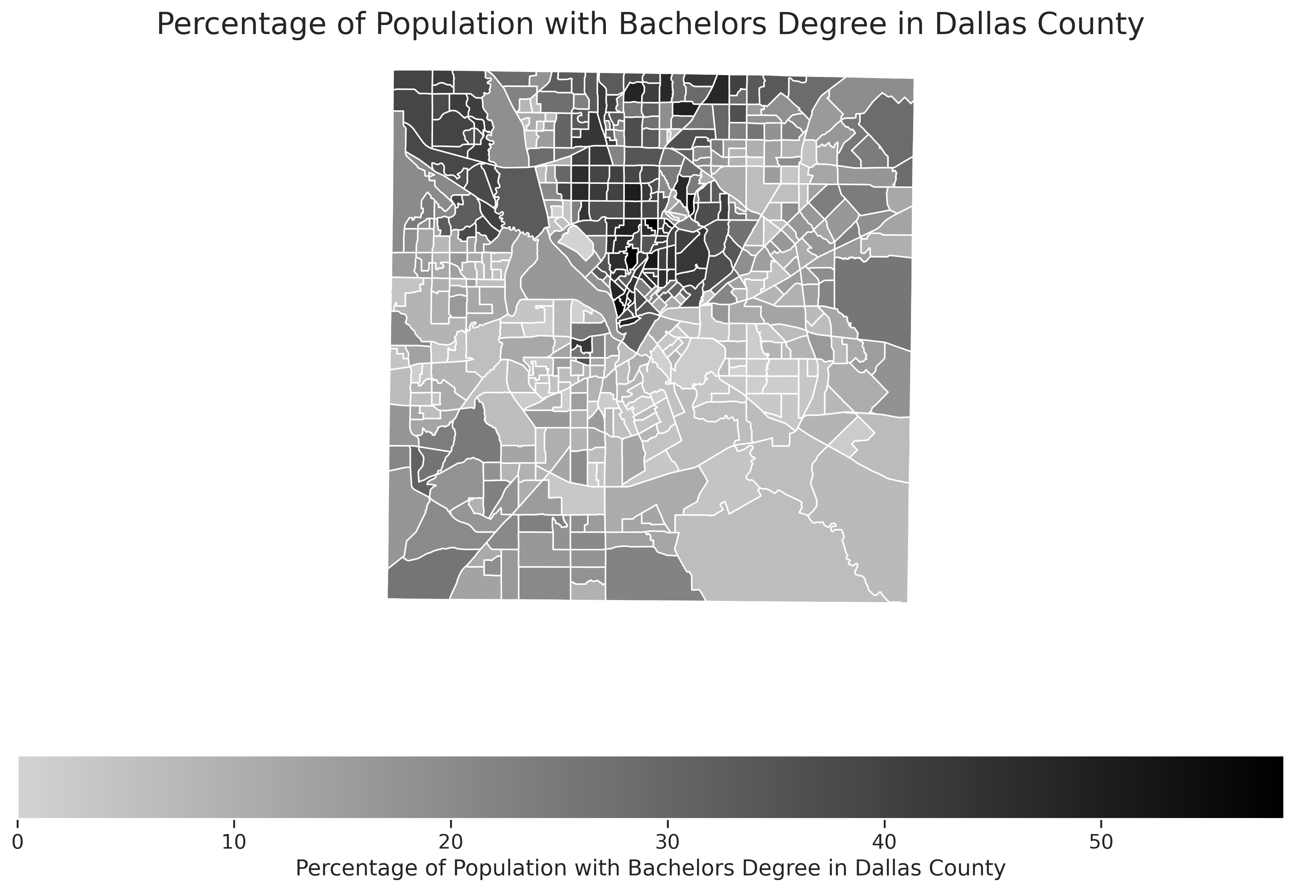

Slide 6
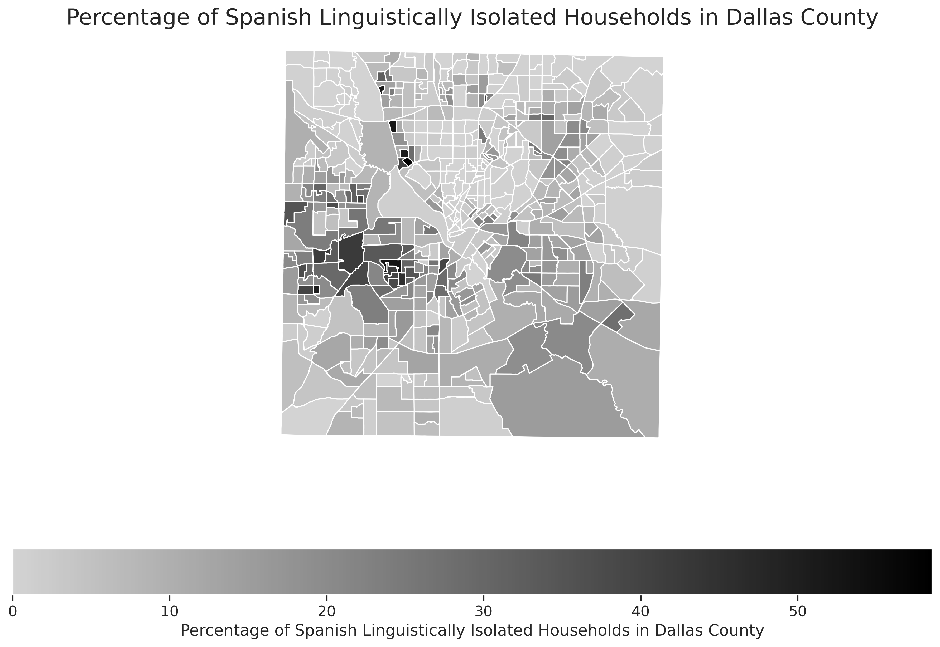

Slide 7
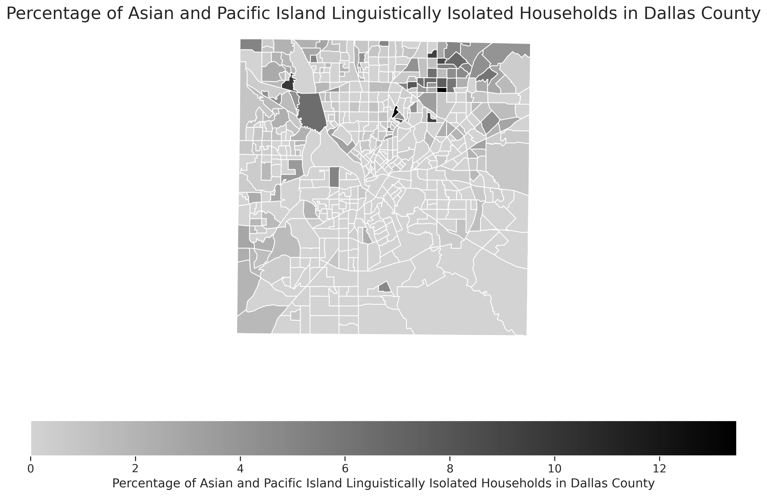

Slide 8
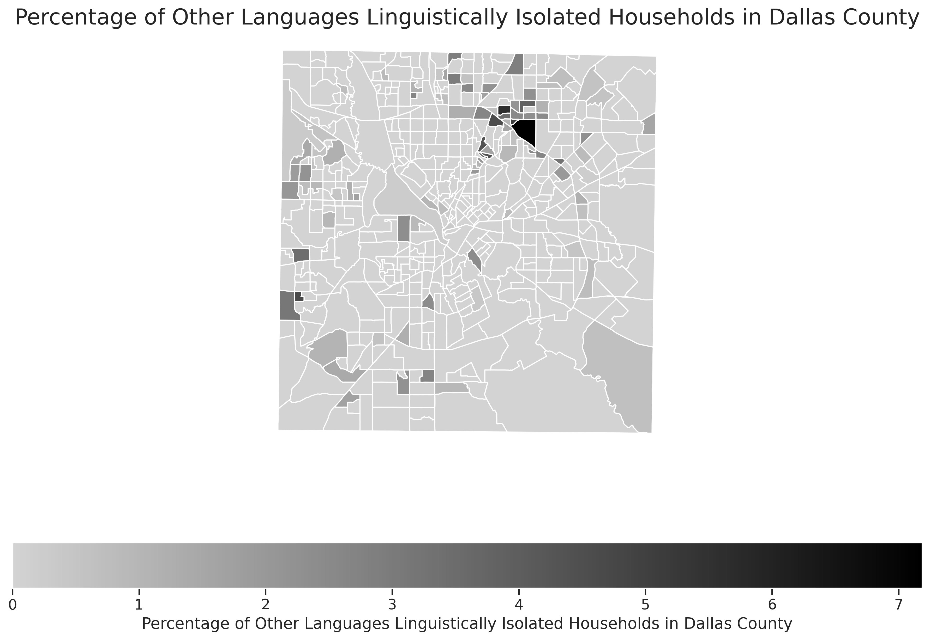

Slide 9
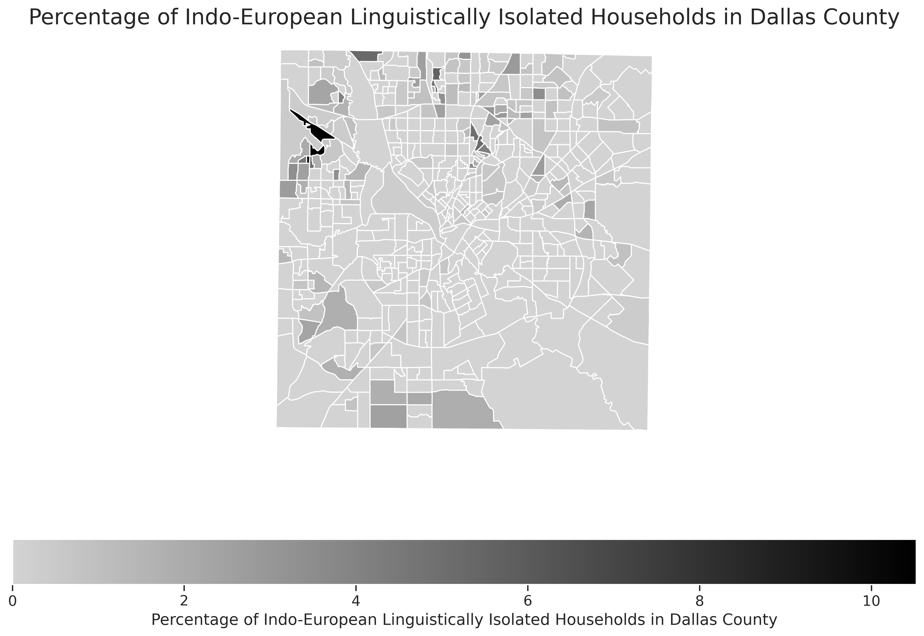

Slide 10
Analysis Methodology
Correlation Analysis:
Generated a correlation matrix to understand direct relationships between language isolation and median income.
This step provided simple associations without controlling for other factors.
Multivariate Regression Analysis:
Conducted to isolate the effects of each variable on median income.
Controlled for educational attainment (bachelor's and master's degrees) and employment rates.
Used z-scores to filter out outliers (threshold: 3 standard deviations) to avoid skewed results.

Slide 11
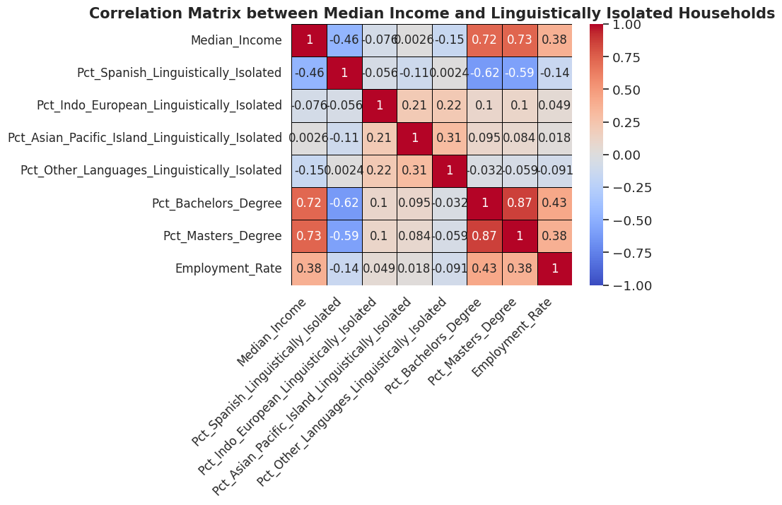

Slide 12
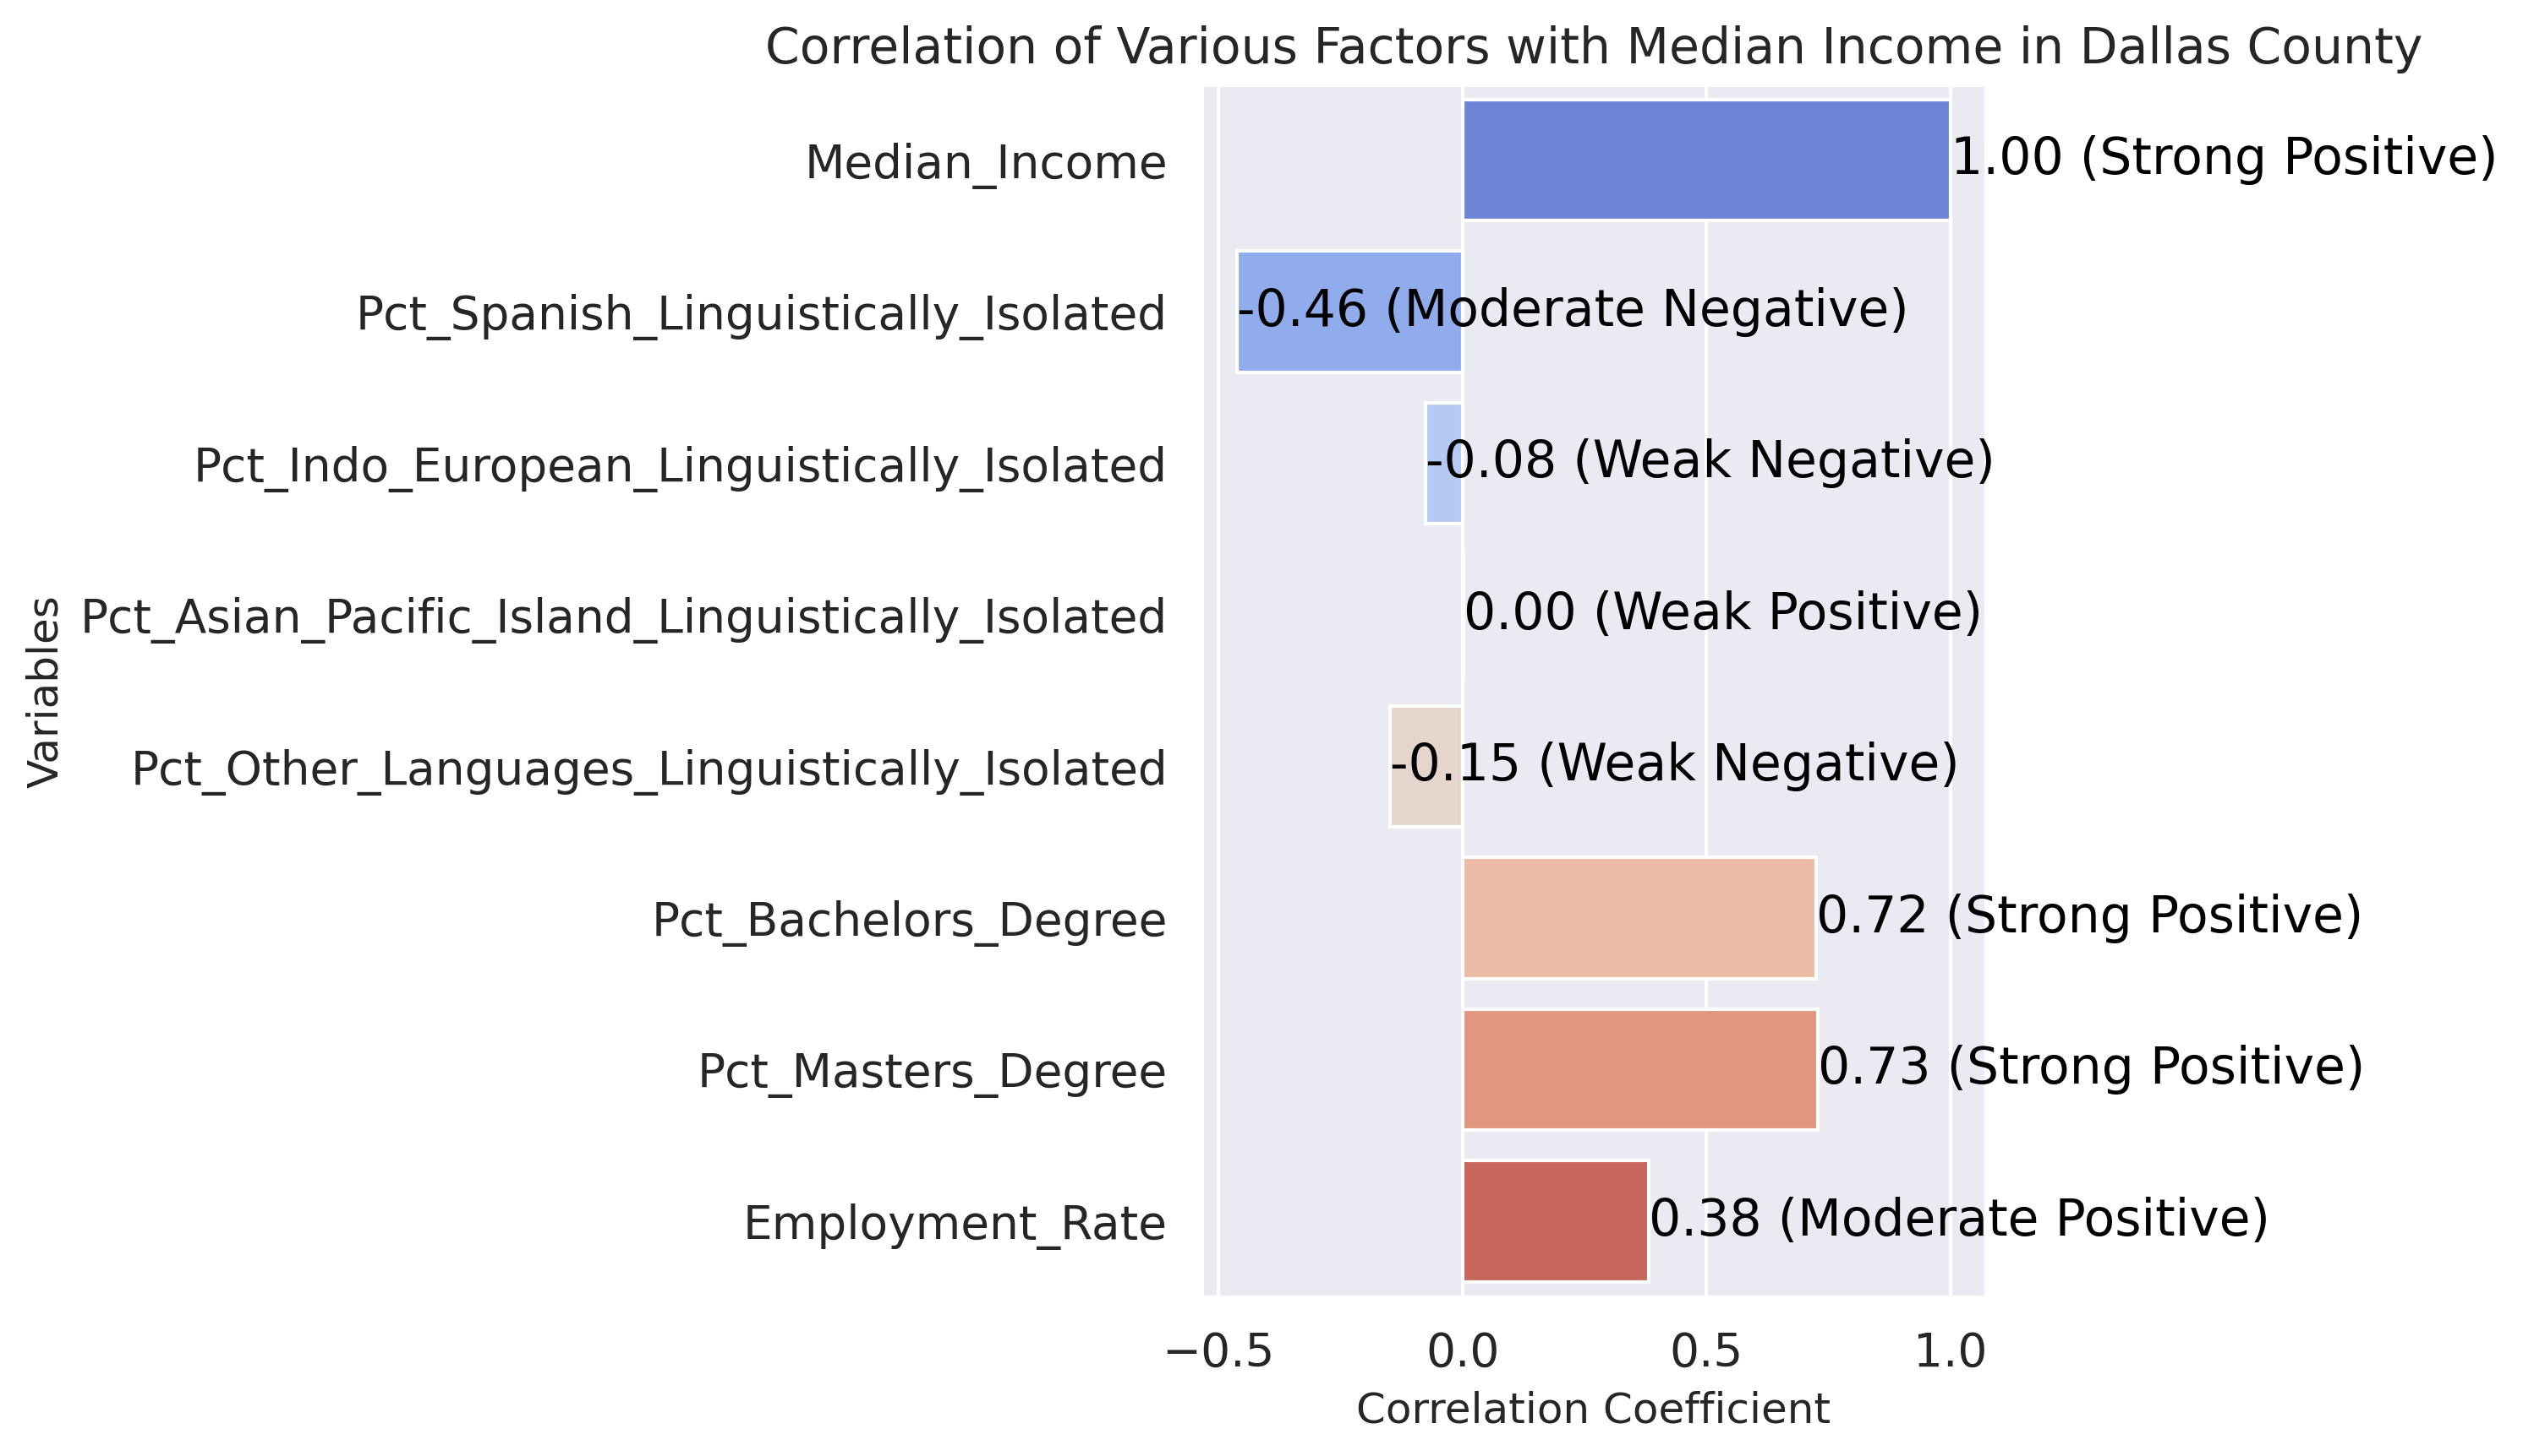
Correlation Results
Correlation analysis provides a simple measure of association between two variables without controlling for others.

Slide 13
Regression results
2.12e-91
2.12e-91
Adjusted R-squared: 0.617 This indicates that 61.7% of the variability in median income is explained by the independent variables in the model.
The F-statistic (106.46) indicates that the overall regression model fits the data well and explains a significant portion of the variability in the median income.
The Prob (F-statistic) of 2.12e-91 shows that the likelihood of the observed relationship being due to chance is virtually zero, providing strong evidence that the predictors collectively have a significant impact on the median income.

Slide 14
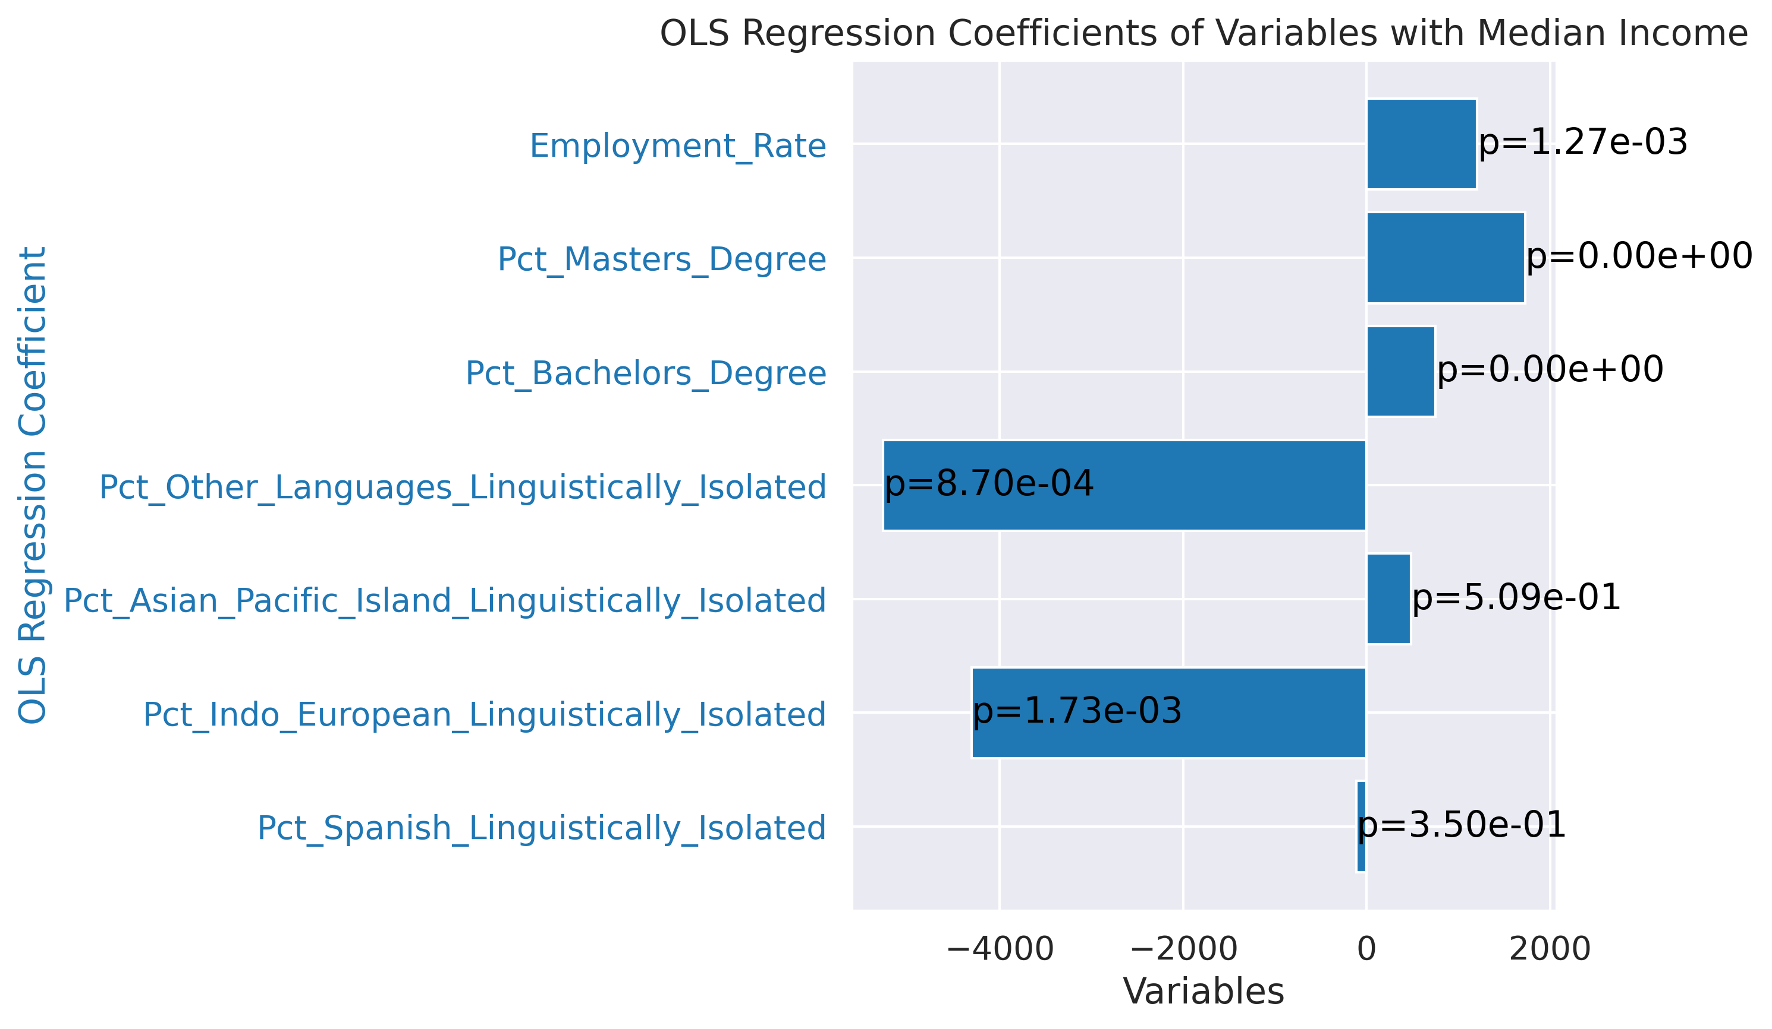
Regression analysis controls for multiple variables, isolating the effect of each independent variable on the dependent variable.

Slide 15
Positive Impacts:
Pct_Bachelors_Degree: Each percentage point increase in the population with a bachelor's degree is associated with an increase of approximately $752.25 in median income.
Pct_Masters_Degree: Each percentage point increase in the population with a master's degree is associated with an increase of approximately $1726.62 in median income.
Employment_Rate: Each percentage point increase in the employment rate is associated with an increase of approximately $1206.14 in median income.

Slide 16
Negative Impacts:
Pct_Indo_European_Linguistically_Isolated: Each percentage point increase in Indo-European linguistically isolated households is associated with a decrease of approximately $4307.95 in median income.
Pct_Other_Languages_Linguistically_Isolated: Each percentage point increase in other languages linguistically isolated households is associated with a decrease of approximately $5270.73 in median income.

Slide 17
Conclusion
The regression analysis provides a nuanced understanding of how various factors affect median income:
Higher education levels and employment rates are strongly beneficial to median income.
Linguistic isolation in certain groups can significantly hinder economic outcomes.
Insignificant results for some variables indicate that their impact might be explained by other socio-economic factors.
These findings highlight the importance of considering multiple socio-economic variables to understand their combined impact on median income.

Slide 18
Future research directions
Time-Series Data: Analyze data over a longer period to identify trends and changes in the impact of linguistic isolation on median income.
Cohort Studies: Conduct studies on specific cohorts to understand long-term effects of linguistic isolation on economic outcomes.
Spatial Regression Models: Further refine spatial models to include different types of spatial dependencies and interactions.
Interviews and Surveys: Conduct qualitative research through interviews and surveys to gain deeper insights into how linguistic isolation affects economic opportunities and integration.
Case Studies: Develop case studies on specific communities to understand the contextual factors influencing the relationship between language isolation and income.
Age and Gender: Include age and gender demographics to understand how these factors interact with linguistic isolation to affect median income.
Immigration Status: Incorporate data on immigration status and duration of residence to examine their influence on economic outcomes.

